Slide 1
Group 3: GAI for Education
Michael Soebroto, Mohnish Sai Prasad, Rithesh Kumar
Bi-weekly Update Week 7

Slide 2
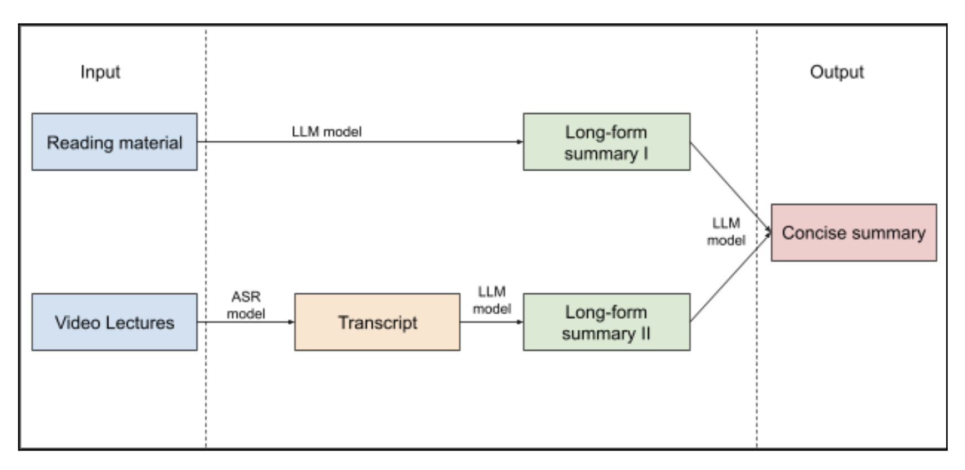
Project Background
Problem: There a large amount of course material out there and it is time consuming to go through. Students often have a very short attention-span for tasks like these which causes inefficient learning.
Goal: Condense learning material into shortened content in order to improve the learning experience.
Solution: We aim to create a tool that turns a collection of video lectures and reading material into a more consumable format.

Slide 3
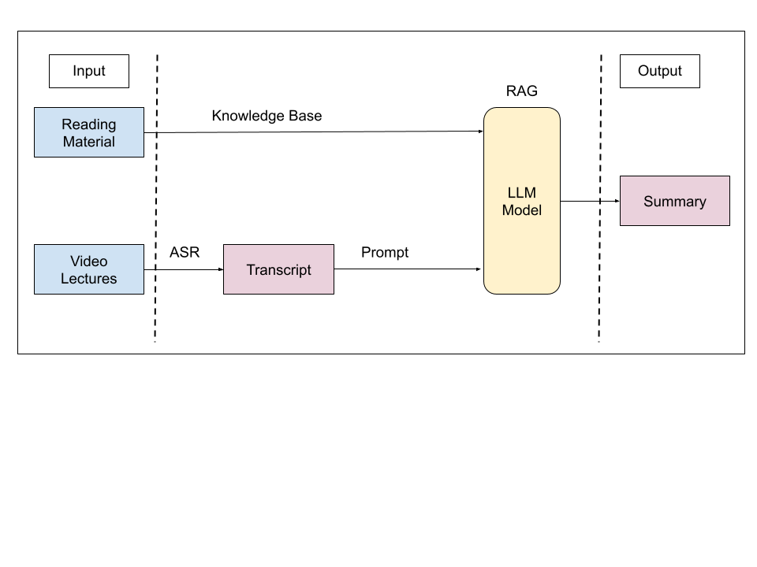
Updated pipeline - RAG
Generating the summaries separately for video and reading materials can lose information from the reading material.
Propose a RAG model which uses the reading material as a knowledge base
Use an LLM to generate a summary of the video transcript with access to the knowledge base
Train the LLM to fetch additional information from the knowledge base and refine the Summary

Slide 4
Project Status
Current status
Completed the analysis on the existing RAG approaches for Summarization tasks
Built a pipeline that uses RAG for Summarization instead of having an LLM combine two summaries
Changes from last time
Changed the workflow: Instead of summarizing separately, we create a summary from the video transcript, with the help of RAG using the reading material as a knowledge base to enhance the quality of the summary.
Plan for next cycle
Finish up the human-generated summaries
Train using Few-shot learning on the RAG models
Use BertScore to validate model training (not for overall evaluation)
Setup final evaluation survey

Slide 5
Individual Status
Team Member | What I did in the last two weeks
Michael | Creating human-generated summaries for video dataset
Mohnish | Rebuilt the summarization pipeline based on RAG implementation Used ChromaDB as a vector Knowledge Store to store the reading material content for the model to access Used Llama 2 (7b and 13b) model to summarize the video content but faced few setbacks
Rithesh | Using RAG models for Zero-shot learning to check the current performance in the pipeline Cleaning up the data for few-shot learning of the RAG models (Prompt engineering)

Slide 6
Overall Schedule
Updated Timeline
Week 7 - 8: Fine-tuning LLMs using few-shot learning to fit the problem, and evaluating using human generated summaries.
Week 9: Send out evaluation survey
Week 10: Final touches and presentation

Slide 7
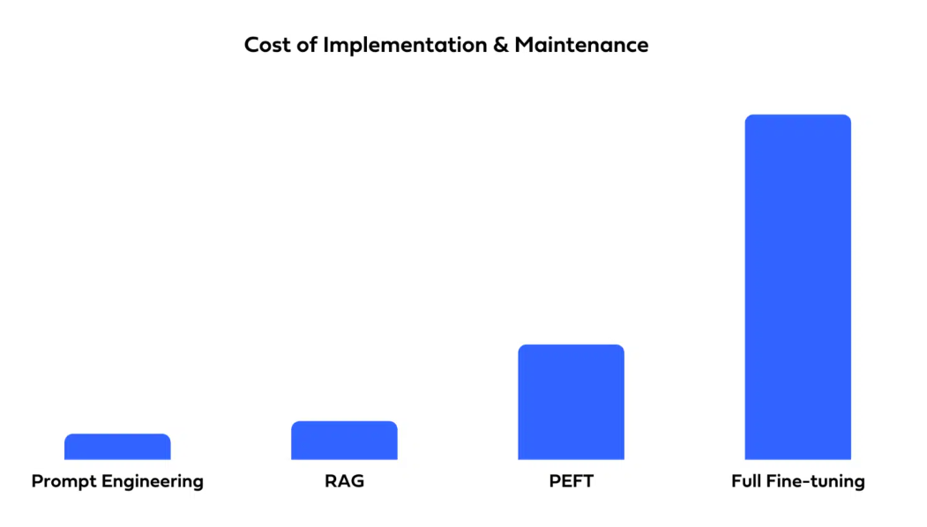
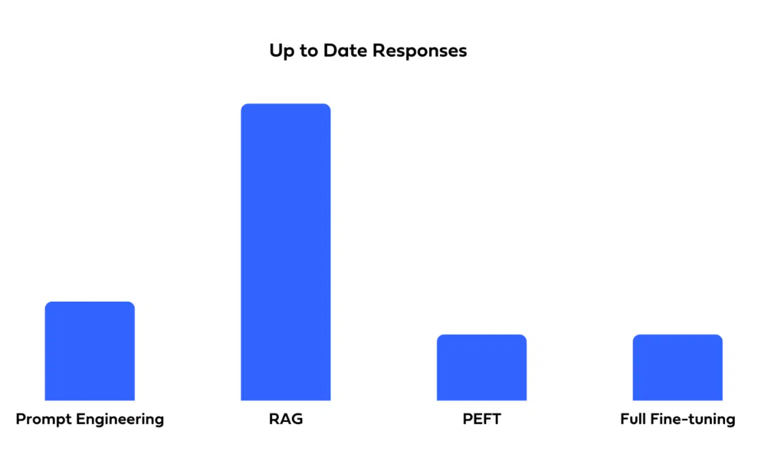
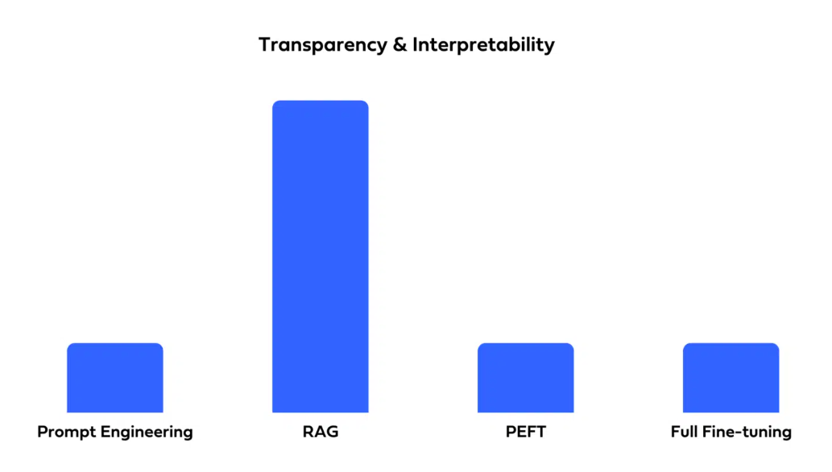
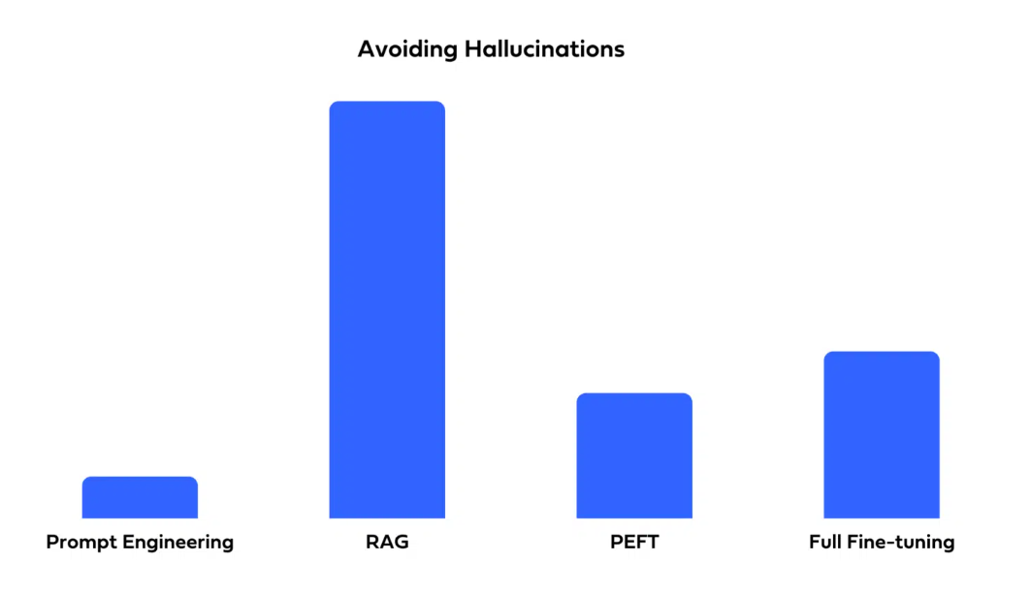
Interesting Findings
Training methods: Fine-tuning vs PEFT vs Prompt Engineering vs RAG
We are using RAG in our main pipeline - Benefits of RAG is covered.
We are using Prompt Engineering to train our model - Combining with RAG covers a lot of advantages with low cost of implementation.

Slide 8
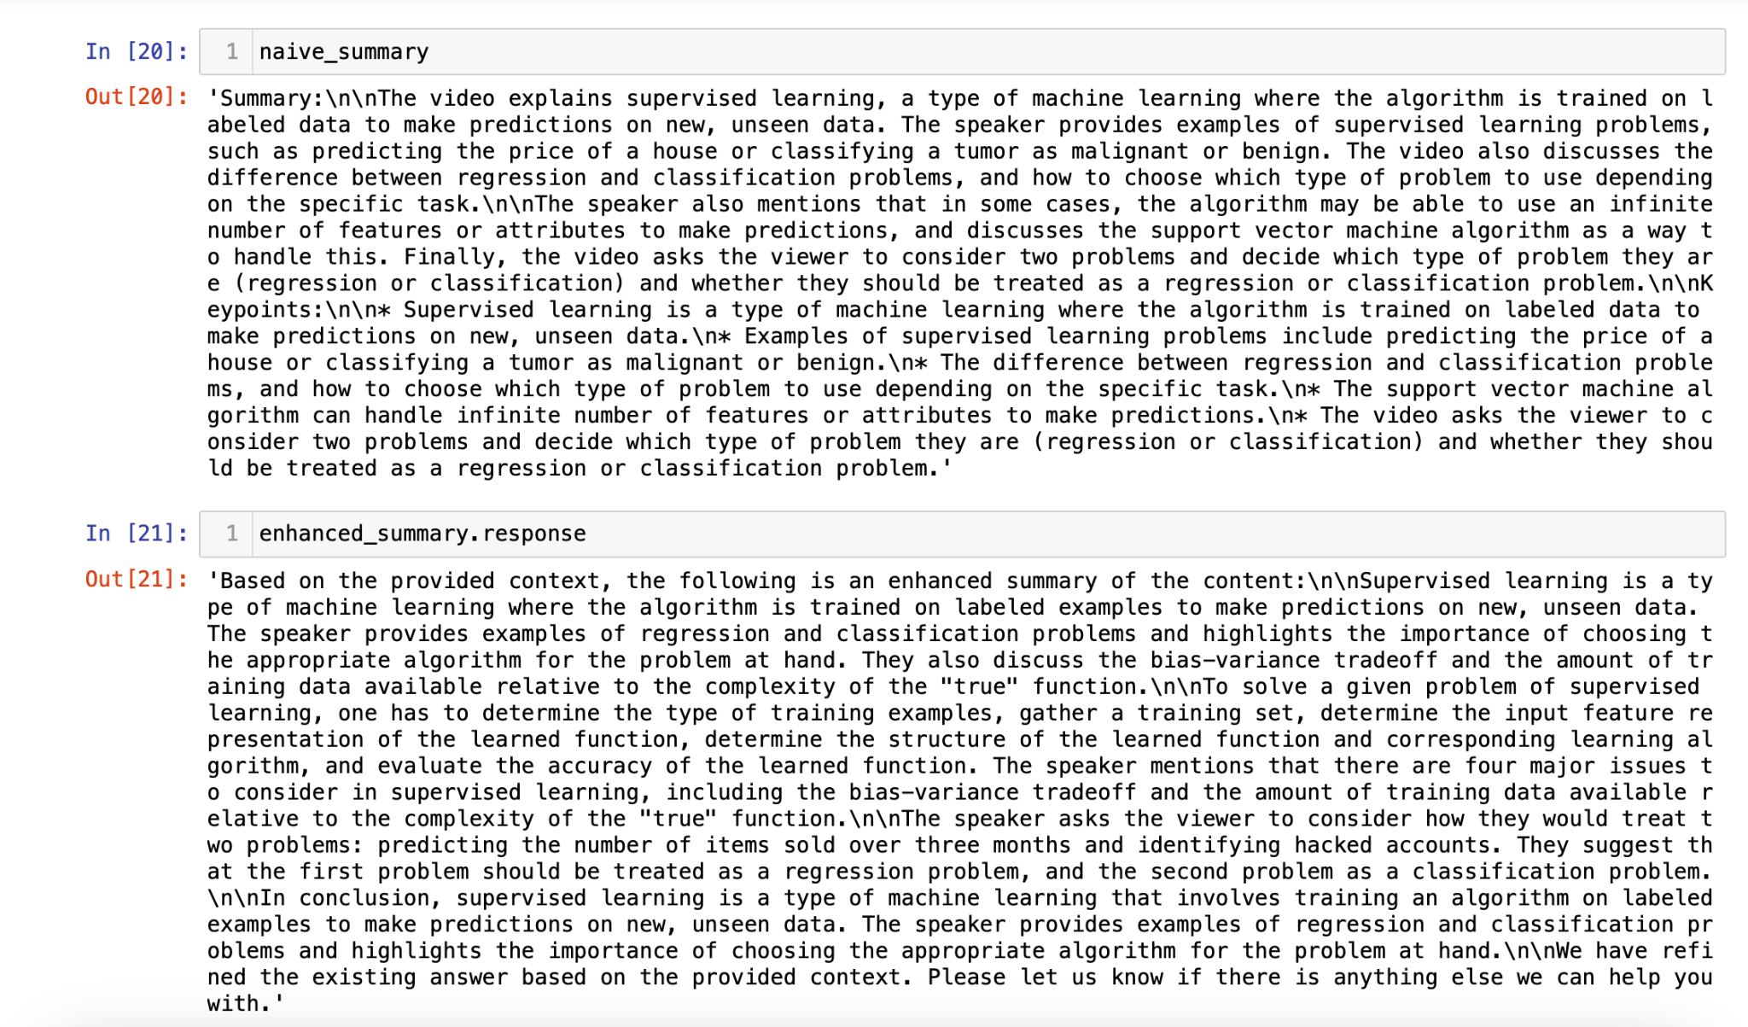
Llama 13B model performed better but required more RAM

Slide 9
Thank You

